Slide 1
Relationship between Pointers and Arrays
Mohammad Salman

Slide 2
Recall Some Behaviors of Arrays…
What does the following statement print on the terminal?
int arr1[8]{};
std::cout << arr1 << std::endl;
Some address gets printed on the screen.
Notes:
Some address got printed.

Slide 3
Recall Some Behaviors of Arrays…
Also, recall what happened when you did the following.
void externalFunc(int arr[], int len)
{
std::cout << sizeof(arr) << std::endl;
}
Also, the output is independent of the length and data type of the array.
Notes:
The output was always a fixed integer.

Slide 4
Explanation: Arrays Decay into Pointers
The array decays (implicitly gets converted) into a pointer that points at the first element of the array.
int[10] → int*
Consequently, these two statements will print the same thing.
int arr[10]{};
std::cout << &arr[0];
// “arr” implicitly gets converted to int*
std::cout << arr;
/* “arr” implicitly gets converted to int* then it’s dereferenced. */
std::cout << *arr;

Slide 5
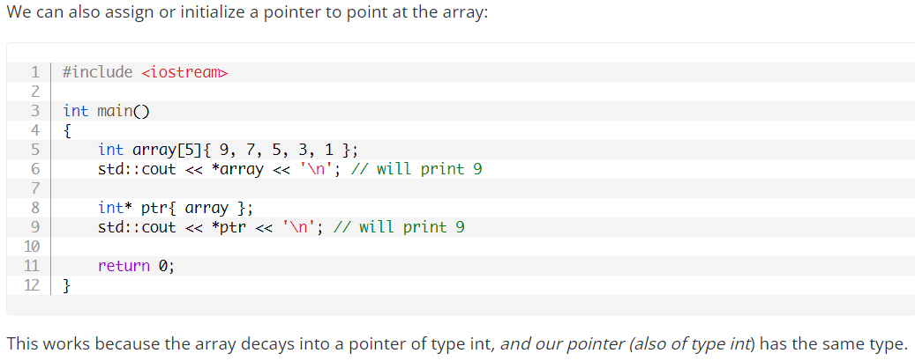
Explanation: Arrays Decay into Pointers
Note the initialization.
int* ptr{ array };
Implicit conversion to pointer, data types become same, initialization happens.

Slide 6
Explanation: Arrays Decay into Pointers
Hopefully, the second weird behavior with arrays would also start making sense…

Slide 7
#include<iostream>
void printLength(int arr[])
{
std::cout << "In printLength()\n";
std::cout << sizeof(int*) << '\n'
<< sizeof(arr) << '\n';
}
int main()
{
int zeros[7]{};
// In main()
std::cout << sizeof(zeros) << std::endl;
printLength(zeros);
return 0;
}
Both of these will print the size of a pointer (a memory address).
It will either be 4 or 8 bytes (depending on your system architecture).
It has decayed to an int* type.
This will print the total size occupied by the array.
It will be 28 bytes.
It’s being treated as an “array” type so to speak (no decay has happened).
The type would be int[7].

Slide 8
#include<iostream>
void printLength(int arr[])
{
std::cout << "In printLength()\n";
std::cout << sizeof(int*) << '\n'
<< sizeof(arr) << '\n';
}
int main()
{
int zeros[7]{};
// In main()
std::cout << sizeof(zeros) << std::endl;
printLength(zeros);
return 0;
}
Both of these will print the size of a pointer (a memory address).
It will either be 4 or 8 bytes (depending on your system architecture).
It has decayed to an int* type.
This actually leads to something interesting…
This will print the total size occupied by the array.
It will be 28 bytes.
It’s being treated as an “array” type so to speak (no decay has happened).
The type would be int[7].

Slide 9

void foo(int arr[], int len)
{
// Some statements
}
void foo(int* arr, int len)
{
// Some statements
}
Decay
int[7] → int*
Decay
int[7] → int*
int main()
{
int zeros[7]{};
foo(zeros, 7);
return 0;
}
Notes:
Best practice is because of readability reasons. The intent is clear.

Slide 10
Exceptions to: Arrays Decay into Pointers
There are some situations where arrays don’t decay into pointers.
When using the sizeof() operator.
When used in a different function, note that the array has already decayed.
When using the address-of operator (&).

Slide 11
Exceptions to: Arrays Decay into Pointers
Btw, typeid(var).name(), is a way to see the data type of a certain variable.
When using the address-of operator (&).
int array[5]{2, 3, 5, 7, 11};
std::cout << typeid(array).name() << std::endl;
std::cout << typeid(&array).name() << std::endl;
std::cout << array << ", " << &array << std::endl;
The type is int(*)[5] (pointer to int[5]).
The address values would be the same (output of the last line).
It’s just the data type of the pointer/address that has changed.
It is unlikely that you will encounter this situation…

Slide 12
Key Takeaways from Monday
Dangling pointer is a pointer that holds the address of an entity that is no longer valid.
Ensure all dangling pointers are set to nullptr.
Be careful when dereferencing pointers (in general).
When a fixed array is used in an expression, the fixed array will decay (be implicitly converted) into a pointer.
Change in data type.
This pointer points at the first element of the array.
There are some exceptions to this rule.
Simply put, the name of the array variable can be considered (mostly) to be a pointer pointing to the first element of the array.

Slide 13
An Important Point from Wednesday (Lab)

Slide 14
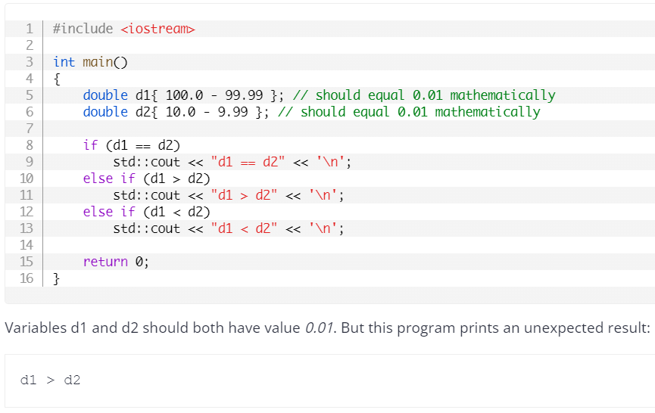
Comparing Floating Point Values
We talked about how comparing two floating point values is unreliable.

Slide 15
Comparing Floating Point Values
This situation also came up during your lab (points on a line).
Here is a way to solve that problem.

Slide 16
Comparing Floating Point Values
Let’s say you have two floating point values,
a = 10.00101
b = 10.00092
Whether these numbers are the same or not, might depend on the context in which they’re being used.
If these are lengths of two pencils, we would probably say that they are the same.
If these are lengths of two mechanical parts that fits into a spacecraft or a Formula-1 racecar, we might think otherwise.

Slide 17
Comparing Floating Point Values
a = 10.00101
b = 10.00092
The point is that the acceptable precision can vary.
When comparing floating point values, you can make use of this concept.
Let’s say you are comparing the lengths of two pencils, you can set your precision to be 0.01.
In this e.g., both numbers become the same.

Slide 18
So let’s try to create a function for this.
bool approxEqual(double a, double b, double prec)
{
return std::abs(a - b) <= prec;
}
a = 10.00101
b = 10.00092
prec = 0.01
You’ll need,
#include<cmath>
for using std::abs()

Slide 19
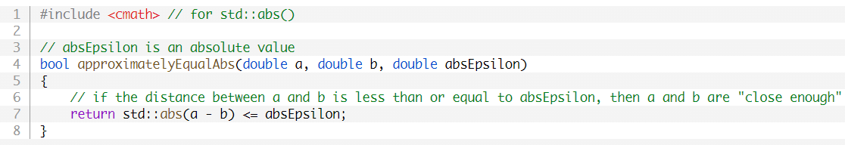
Comparing Floating Point Values
The precision is generally called “epsilon”.
Following shows more details in comments.
Functionally, what I showed before, does the same thing.
Notes:
https://www.learncpp.com/cpp-tutorial/relational-operators-and-floating-point-comparisons/

Slide 20
Pointer Arithmetic

Slide 21
Pointer Arithmetic
Let’s say you have a pointer pointing to an integer.
Note that this is an int type pointer.
ptr → 100 (Note this is not the address where ptr is stored).
Adding 1 to it, will cause your pointer to increment by 1*sizeof(int).
(ptr + 1) → 100 + (1*4) → 104
(ptr + 4) → 100 + (4*4) → 116

Slide 22
Note
Using base10 system to represent addresses.
Keep things easy to understand.
This is a snippet of some of the memory addresses.
… | 100 | 101 | 102 | 103 | 104 | 105 | 106 | 107 | 108 | 109 | 110 | 111 | 112 | 113 | 114 | 115 | 116 | …
ptr
(ptr + 1)
(ptr + 4)

Slide 23
Pointer Arithmetic
Subtraction behaves in a similar way.
Assuming that, again, ptr → 100.
(ptr - 1) → 100 - (1*4) → 96
(ptr - 4) → 100 - (4*4) → 84
What if pointer was pointing at a double?
ptr = 1000.
(ptr + 3) → ???
Notes:
For the last question.
1000 + (8*3) = 1024

Slide 24
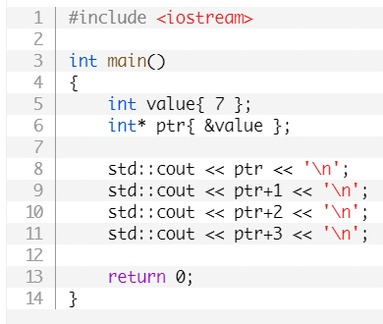
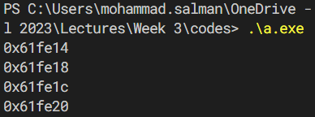
Pointer Arithmetic
Question
What will happen if I dereference any of these pointers (lines 9 through 11)?
Notes:
Question’s answer
Bad idea; dangling pointers.

Slide 25
Arrays in Memory

Slide 26
Let’s say we have an array,
int prime[5]{2, 3, 5, 7, 11};
Its representation will be as follows.
0 | 1 | 2 | 3 | 4
2 | 3 | 5 | 7 | 11
0x10 | 0x14 | 0x18 | 0x22 | 0x26
Recall from DSA that in an array, all elements are contiguous, i.e. the elements are next to one another.
Note that every entity has to be saved in memory.
In this case, we have five integers (4 bytes each).

Slide 27
Array Structure
So basically,
&prime[0] = start_address + 0*sizeof(dtype),
&prime[1] = start_address + 1*sizeof(dtype),
&prime[2] = start_address + 2*sizeof(dtype),
&prime[3] = start_address + 3*sizeof(dtype),
And so on…

Slide 28
Using Pointer Arithmetic to Traverse an Array
Putting pointer arithmetic and arrays together…

Slide 29
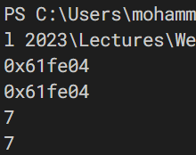
#include <iostream>
int main()
{
int array[]{ 9, 7, 5, 3, 1 };
std::cout << &array[1] << '\n';
std::cout << array+1 << '\n';
std::cout << array[1] << '\n';
std::cout << *(array+1) << '\n';
return 0;
}

Slide 30
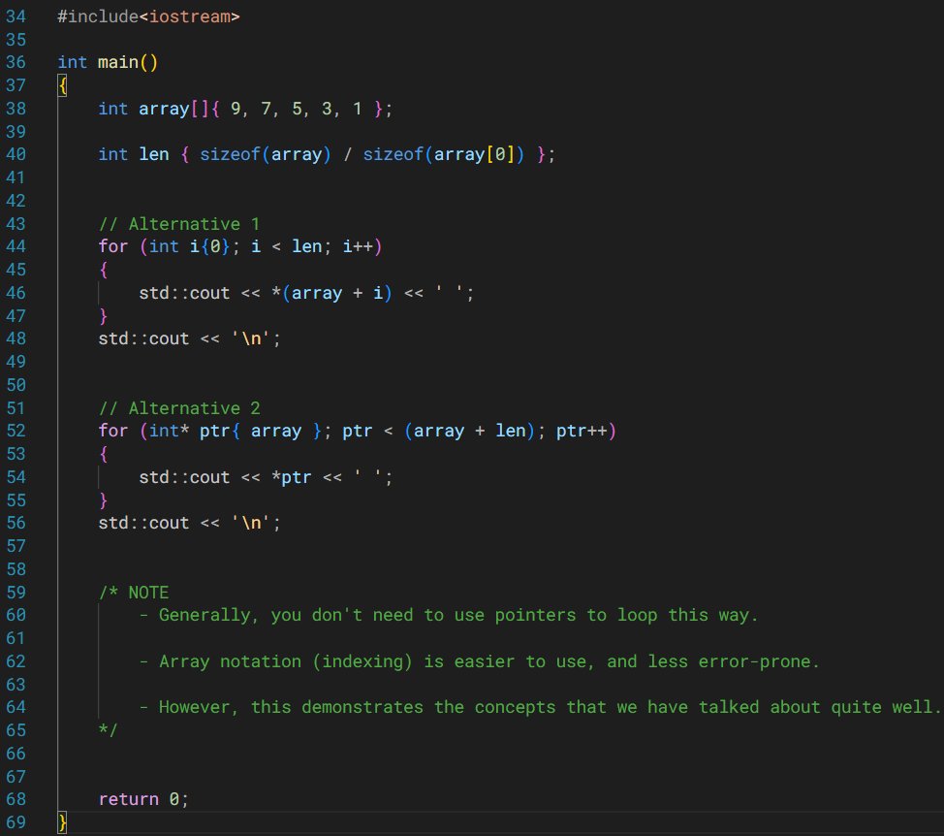
Traversing an array using the concepts that we’ve studied thus far.

Slide 31
Character Arrays / C-Style Strings

Slide 32
C-Style Strings
Inherited from C programming language into C++.
std::string in C++ is also based on C-style strings.
C-style strings are character arrays.
They are null-terminated strings.
C-style strings have a null character (‘\0’) at their end.
This character has an ASCII code = 0.

Slide 33
C-Style Strings
Go to the code files.
Initializing C-style strings.
Null-terminated.
Different behavior with std::cout.

Slide 34
LHS Operand
ostream type object
RHS Operand
dtype of data being printed
Elaboration on the different behavior with std::cout
operator<<
std::cout
<<
(int) // Prints the int
std::cout
<<
(int*) // Prints the address
std::cout
<<
(double*) // Prints the address
std::cout
<<
(char*) // Prints the data
Somewhat unique behavior.

Slide 35
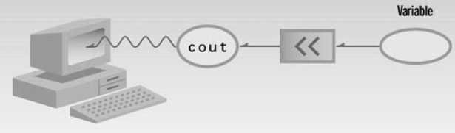
Recall this diagram…
Figure 2.2 from OOP in C++ by Robert Lafore.

Slide 36
Void Pointers (void*)
So how to print a char* type address if we want to?
The void pointer, is a special type of pointer that can point at objects of any data type.
It could also point to objects (whose data types are created by yourself).

Slide 37
Void Pointers (void*) – Limitations
A void pointer has no type information.
Consequently, the following things happen.
You cannot dereference it.
You’ll have to cast it to another pointer type first.
You cannot do pointer arithmetic with it.

Slide 38
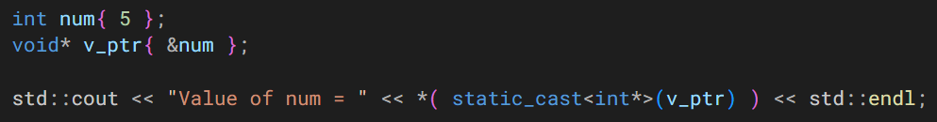
Void Pointers (void*) – Limitations

Slide 39
Length of a C-style String
Please note the distinction between the length of the string and the length of the character array itself.
char myString[15]{ “hello” };
0 | 1 | 2 | 3 | 4 | 5 | 6 | 7 | 8 | 9 | 10 | 11 | 12 | 13 | 14
‘h’ | ‘e’ | ‘l’ | ‘l’ | ‘o’ | ‘\0’

Slide 40
Length of a C-style String
All of this memory can be legally accessed.
But your string of interest only occupies a part of this array.
Using the strlen() function (shown later) gives you length = 5.
Whereas your character array is of length = 15.
0 | 1 | 2 | 3 | 4 | 5 | 6 | 7 | 8 | 9 | 10 | 11 | 12 | 13 | 14
‘h’ | ‘e’ | ‘l’ | ‘l’ | ‘o’ | ‘\0’

Slide 41
C-Style Strings – Helper Functions
There are functions in the <cstring> header file to work with C-style strings.
#include<cstring>

Slide 42
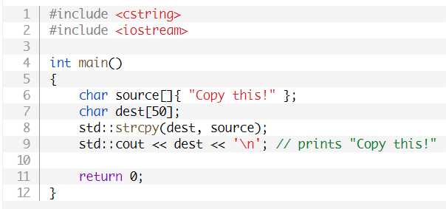
std::strcpy()

Slide 43
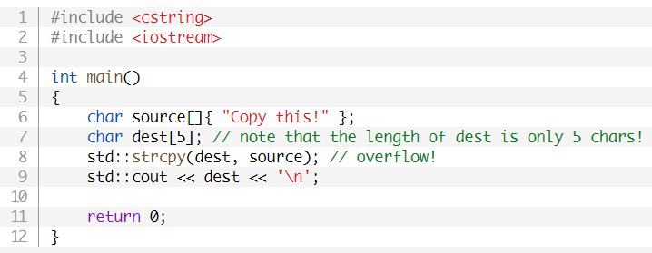
std::strcpy()
Ensure, that the destination array can store all the elements in the source.

Slide 44
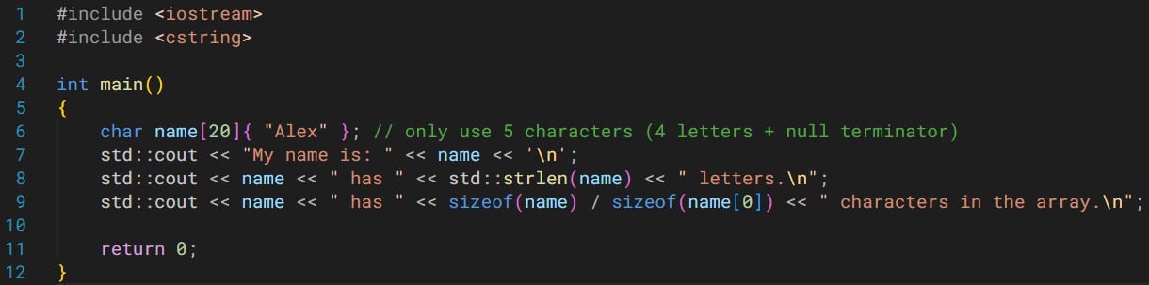
std::strlen()
Gives you the length of the string without the null character.

Slide 45
Other Functions
Appends one string to another.
strcat()
Compares two strings.
strcmp()

Slide 46
General Recommendation
Avoid using C-style strings if you can.
Have various dangers associated with them.
Prefer std::string over C-style strings.
#include<string>
For the purposes of this course, you will be expected to use/know it in various assessments.
They are used in existing codes and various use cases.
So you should understand how they work.

